Slide 1
UNIT
DAY 8
01
THE BRIEF
GAMES OF LOGIC
AGENDA
REMINDERS
Phones into The Holding Cell
Laptops open. Sheet and a pen out as well
This One Counts
What I Am Marking
Three Briefs
The Mark Scheme
Fix Your Worst Slide
Write It
Export and Upload

Slide 2

THIS ONE COUNTS
It’s your first grade of the year! - Criterion A
But it is not just the brief
  Slides 3 to 12 of your folder get marked together, as one thing
The brief is one slide out of ten

Slide 3
WHAT I’M ACTUALLY MARKING
There are four strands for criteria A,
  Three of them are already written in your folder from last time
STRAND | WHAT IT IS | WHERE IT LIVES
i | The need, explained and justified | Slide 3
ii | A research plan, and the research | Slides 4, 6, 7
iii | Analysis of a range of products | Slides 8, 9, 10, 11
iv | The design brief | Slide 12

Slide 4
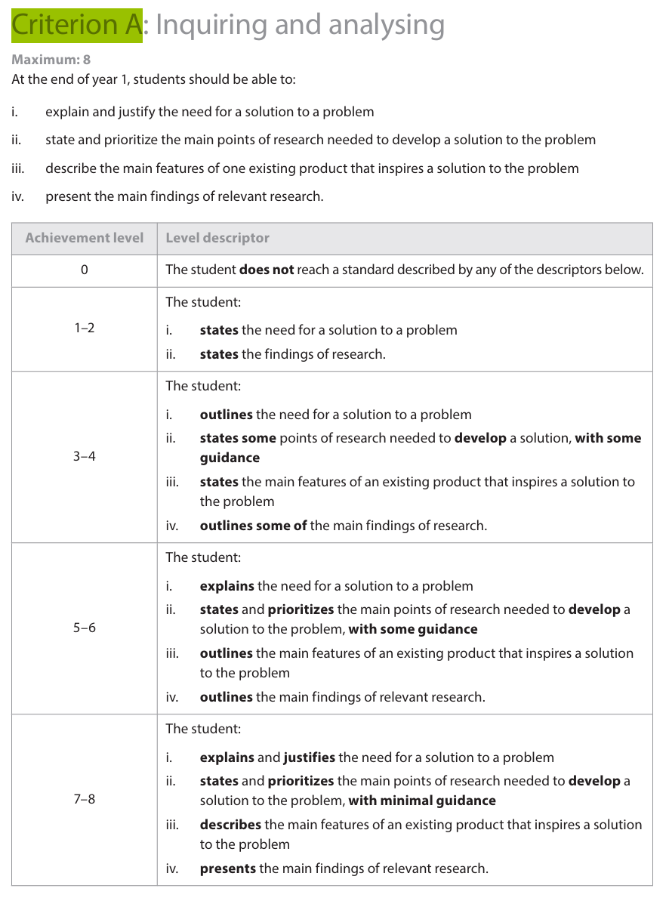
SO CHECK THIS BEFORE ANYTHING ELSE
Open your folder. Look at slides 4, 6 and 7
Only one quarter is the brief
A great brief missing everything else is likely getting a 4

Slide 5
READ THIS ONE
"I am making a card game about sorting for my class. It will be a trick-taking game. It will be fun and quick and the art will look good."
What is wrong with it?
  Not "it is short". What is actually missing?

Slide 6

THREE BRIEFS
On your sheet are three different briefs for the same project
Read all three, then put them in order. Best to worst
Discuss with a partner to see if you agree on what is the best and worst
  You’ve got 15 or so minutes to go through and do that, plus answering the questions
→ LAB Q1 to Q4

Slide 7
HERE IS THE ACTUAL MARK SCHEME
This is the markscheme for the brief itself, not all of criteria A
BAND | THE BRIEF... | WHAT THAT MEANS
1-2 | states the findings | You mentioned research happened
3-4 | outlines the analysis | You said what you looked at
5-6 | explains the analysis | You said what you found and why it matters
7-8 | summarizes the analysis, in detail | The findings are in the brief itself

Slide 8
THE OTHER LADDER, STRAND ii
Same trick on the research plan, and this is the one on slide 4
BAND | THE PLAN... | IN ENGLISH
3-4 | outlines a plan, with some guidance | You said what you would look at
5-6 | constructs a plan, identifies and prioritizes | You ordered it, and said why
7-8 | constructs a detailed plan, independently | Ordered, justified, and nobody told you how

Slide 9
IT IS ONE VERB
That is the whole difference between a 4 and an 8
states → outlines → explains → summarizes
Same for the need on slide 3: states → outlines → explains → explains and justifies
  I’m sure this is no shock for you guys, but this is how pretty much all IB grading is, including your personal project
→ LAB Q5

Slide 10
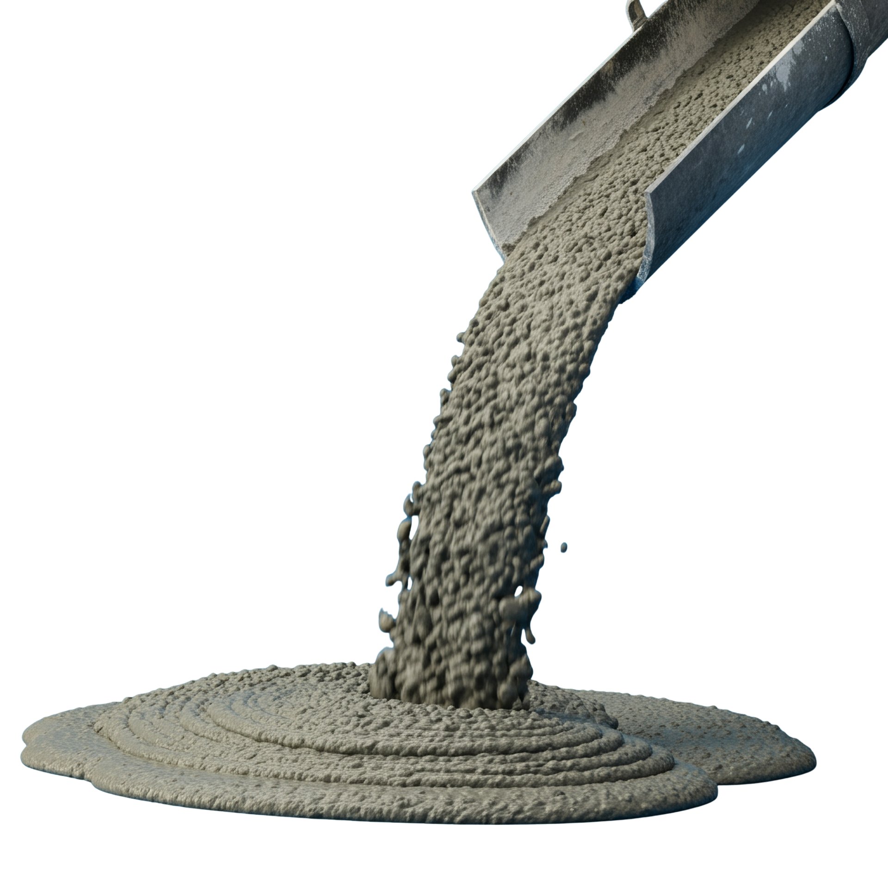
WHAT SPLIT THE THREE
Brief 2 had concrete numbers in it, such as Three minutes, 54 components
Brief 1 said "I looked at two card games" and never said what it found
  That is the difference between explains and summarizes
Brief 3 could be about literally any game anybody has ever made

Slide 11
NOW GO AND FIX YOUR WORST SLIDES
~15 minutes, but you are not writing your brief yet!
Slide 4 - your research plan. What you needed to find out, primary and secondary, most important first
Slide 6 - is the photo of the client cards actually there?
Slide 7 - are there numbers on it, or adjectives?
Slides 8 to 10 - did you say what each game does that yours will need to do?
  Ask me if you have questions or you need some help

Slide 12
WRITING IT
80 to 120 words. That is the whole design brief
Four jobs: what you are making, who for, what it has to do, and what your research says about that
Before you type a single word, write down three numbers you are going to get in there
→ LAB Q6 first, then folder slide 12

Slide 13

~20 MINS FOR DA BRIEF
Slide 12
If you get stuck, read Brief 2 again and use the shape, not just the words

Slide 14
SWAP AND CHECK
Read your partner’s brief with the mark scheme next to you
Can you find a number in it?
Can you tell what they researched?
Can you tell who it is for?
  If the answer is no, say so.
  That is, quite literally, the entire point

Slide 15
EXPORTING IT
File → Download → PDF Document
Name it: Name - Unit 1 - Criterion A
Upload it to ManageBac before you leave
  It will export all 31 slides and most of them are empty
  That is fine, I am marking 3 to 12

Slide 16
CLOSING
Your folder now has a client, a plan, three games taken apart, and an argument for what you are building
You are now complete with the inquiring stage
Next time:
  The specification. Turning all of that into a numbered list of things I can actually test at the playtest

